Slide 1


Target Response Adaptation for Correlation Filter Tracking
Adel Bibi, Matthias Mueller, and Bernard Ghanem
King Abdullah University of Science and Technology (KAUST),
Thuwal, Saudi Arabia
{adel.bibi,matthias.mueller.2,bernard.ghanem}@kaust.edu.sa
Notes:
Hello All, Thank you for coming. This is me Adel Bibi. This is a joint work with Matthias Mueller supervised by Dr. Bernard Ghanem from KAUST. The paper title is “Target Response Adaptation for Correlation Filter Tracking”.
(12 seconds)

Slide 2
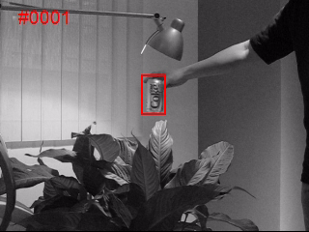
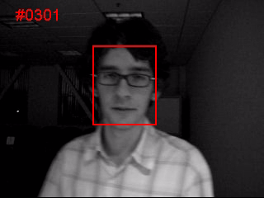
Problem Definition
Goal of Visual Tracking
Estimate the state (position and scale) of the target over time under different conditions
Notes:
We’ll start first by introducing to you what a visual object tracker is. It is the process of estimating the state of a (bounding box) that covers the object of interest in consecutive frames under variety of challenges like (occlusion, fast motion, motion blur, etc.).
(15 seconds)

Slide 3


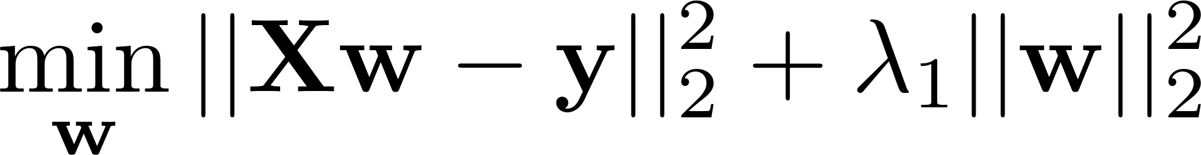

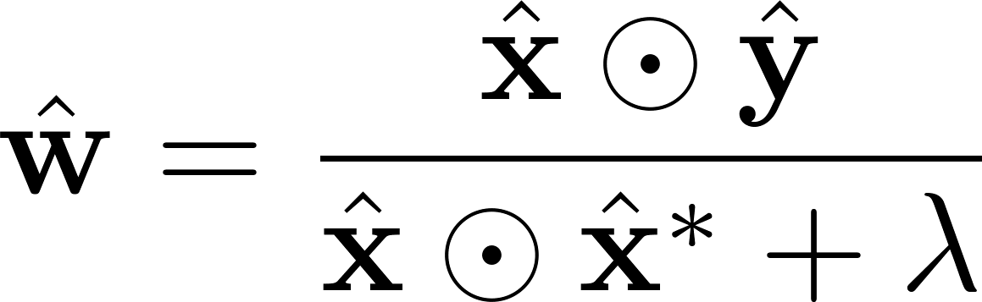
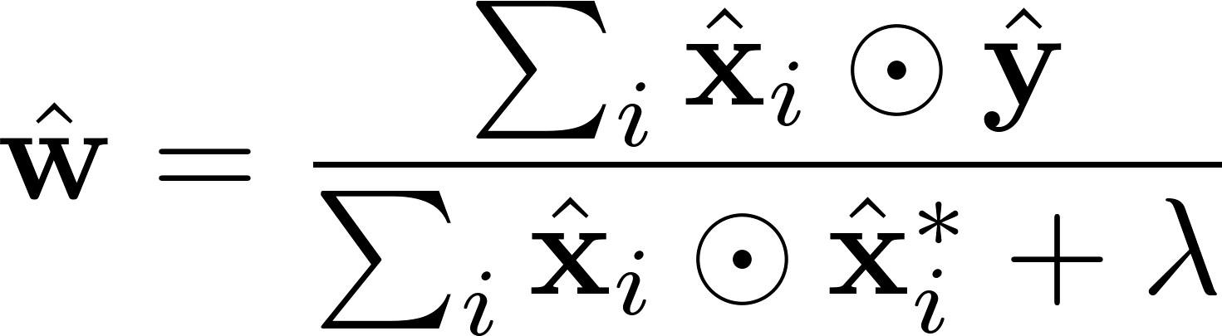
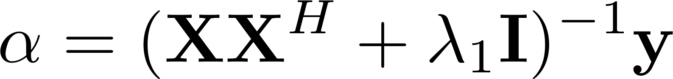
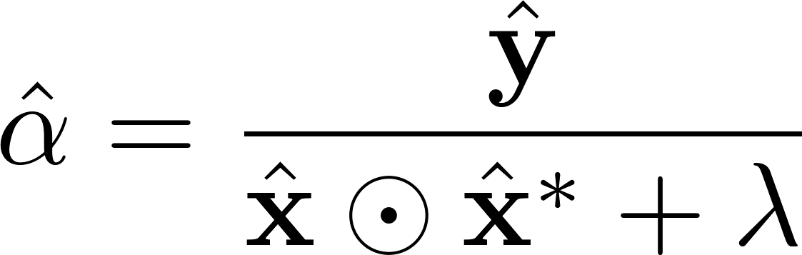

Correlation Filters (Original Formulation)
Primal Solution:
Single Template Solution
Multi-Template Solution
Dual Solution:
Single Template Solution
Notes:
Alright, we are mainly interested in here in correlation trackers.
To give you a brief insight, correlation filters mainly solve this following ridge regression problem. We try to solve for a filter w, that once correlated with the patches in the rows of X should regress to the target response y. However, for computational purposes the data term X is a circulant matrix made of a base template that under the right homogeneity conditions can mimic the effects of object translations in an image.
To solve the following problem, we can either do it in the primal or the dual domain each with it’s benefits.
The primal solution allows us to solve for multiple templates directly but only for a linear kernel; however, the dual solution allows us to use multi dimensional features and kernels but not the multi-template solution.
The other challenge that need to be addressed is how is the target response set? And is it done properly?
The answer is using a gaussian pulse as shown here centered around the base template. The reason behind this is for simplicity, the assumption the object doesn’t move much between consecutive frames, and the to reduce the effect of circular boundary.
(1 min 10 seconds)
Notes:
+ Can you make the text size bigger to fill up the white space more? You have a lot to make use of, especially for the titles of the boxes. Also, make the box boundaries and the arrows much thicker

Slide 4
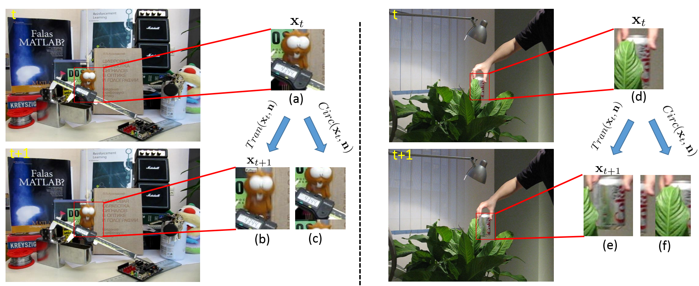
Motivation
Notes:
Here we show the motivation behind our work. Standard correlation trackers will fail under partial occlusion and fast motion videos.
For instance, image patches (b)& (c ) are generated from the previous image patch (a) under an actual translation and the proxy circular translation respectively. As we can see in the patch (c) applying a circular shift to the object while it’s under an occlusion situation would cause the occluder to move along with the object; thus, dramatically affecting the tracking performance.
More clearly in the fast motion category, where the images patches (e ) & (f) are the exact translation and the proxy circular translations to the image patch (d) respectively. In here and again, the patch generated from the circular translation look very different from the actual image patch and thereafter harnessing the tracking performance.
(49 seconds)

Slide 5
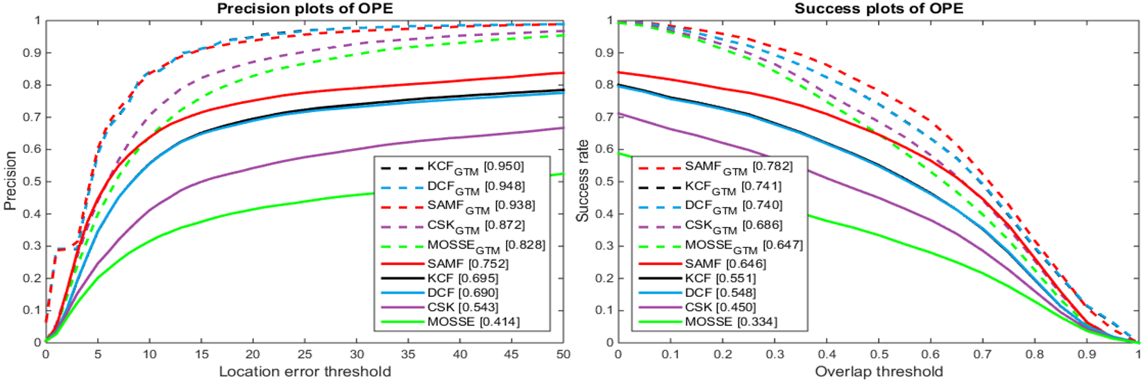
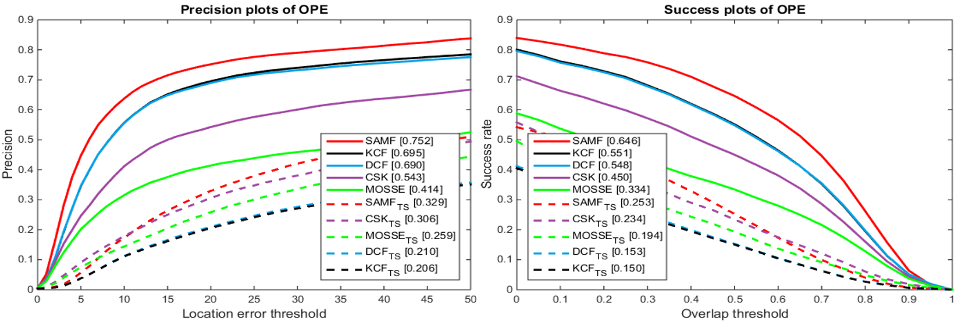
Motivation
Ground Truth Motion Model
At most 2 Pixels perturbation in the target
Notes:
In here, we start by validating the hypothesis to see how sensitive/important is the target response y.
We have 5 baseline correlation trackers plotted in solid lines. On your left, we have re initialized the target response from the GT and as we can see from the (dashed lines) all trackers perform significantly better almost saturating the dataset which is OTB100.
Similarly, if we would have perturbed the target response y by at most 2 pixels randomly in each frame, we notice a significant drop in performance as can be seen in the bottom row.
This demonstrates say a lot about how important choosing y is and how sensitive it is.
So the question here, can we do better than this Gaussian pulse?
(43 seconds)
Notes:
+ it’ll be best to show only two plots: the same measure for the ground truth motion model and the 2 pixel perturbation (preferably the success plot. We don’t need both measures. Make those plots big and put them side by side to fill up the slide.

Slide 6
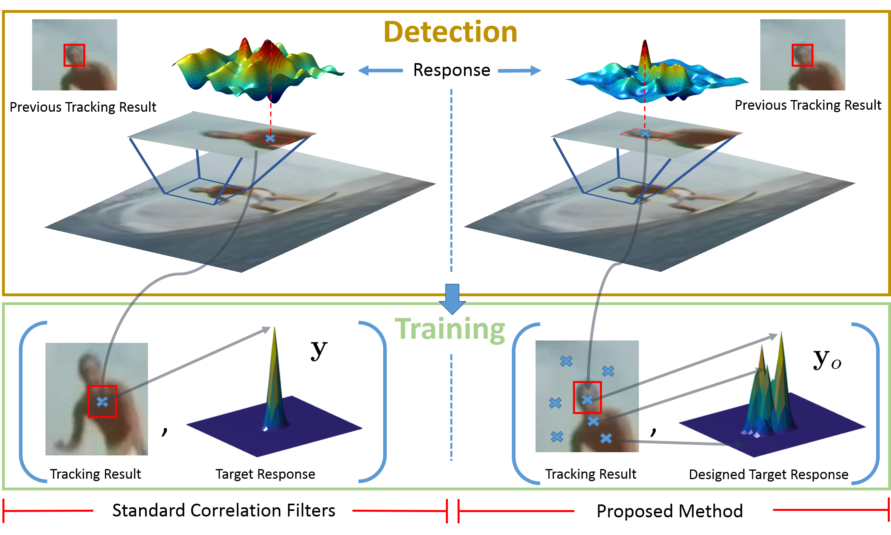
Proposed Pipeline
Notes:
The proposed pipeline goes a s follows:
In the left column is the standard correlation trackers while the one in the right is our framework. In ours, we replace y with an observation y_0 that holds exact translation detections from the image. Unlike before, where even if we had an incorrect detection the tracker can still recover as it is trained over y_o. In our framework, Y_o here can be interpreted as a prior knowledge on the motion model. In an ideal scenario, we would wish to sample all the translations in the image; however, that defies the purpose of using the circulant property and thus we stick to interpolating the samples.
(39 seconds)

Slide 7
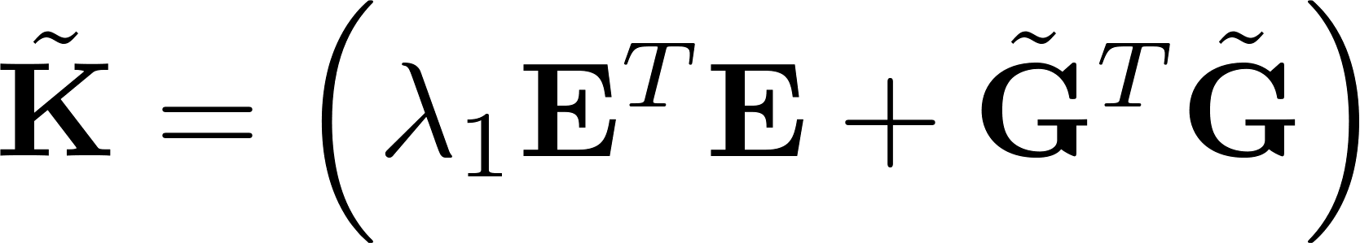
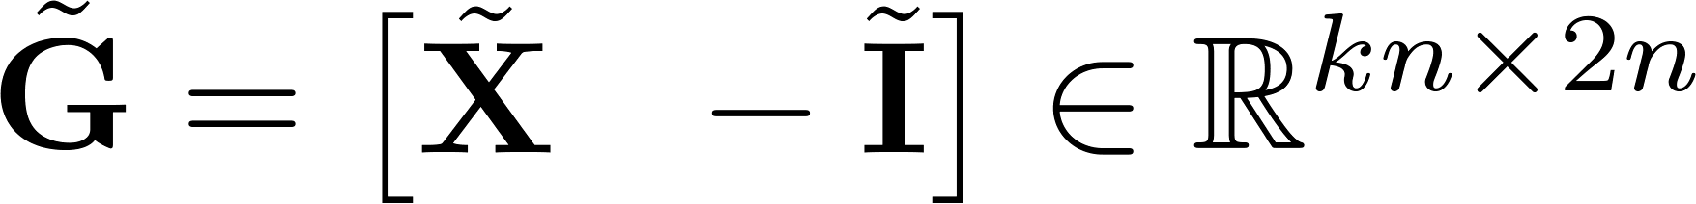
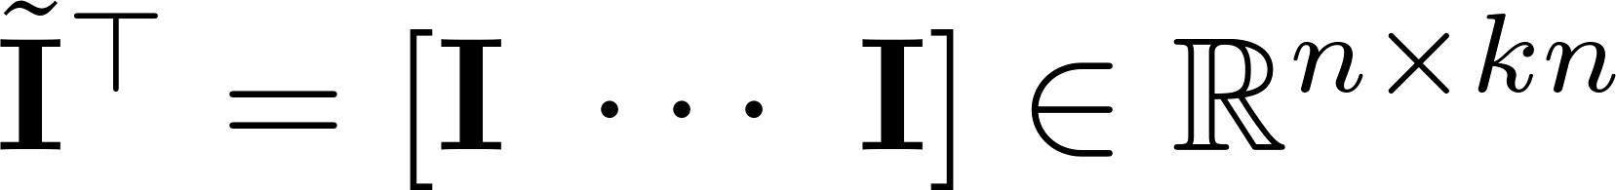
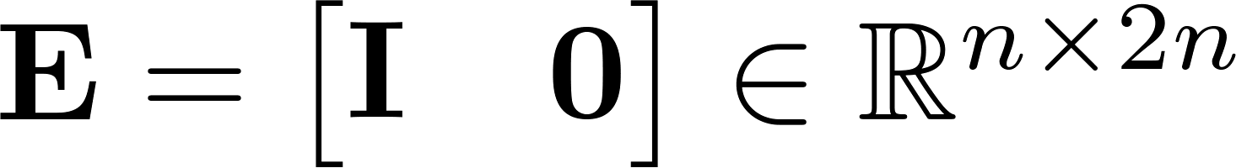
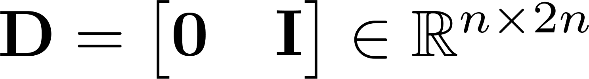
Proposed Method
Notes:
Therefore, we add the following regularize to the standard problem and replace the data matrix with the mutilple template case such that (X_tilde) is block circulant.
The equivalent dual problem is given as follows, with some treatment to the problem and the use of woodburry matrix identiy.
(17 seconds)
Notes:
+ do you talk about how y0 is generated here? Or before? (True, I talk about it in the previous slide.)
+ bigger font; put boxes naming the different elements, e.g. optimal filter, optimal target response, and target response prior.

Slide 8

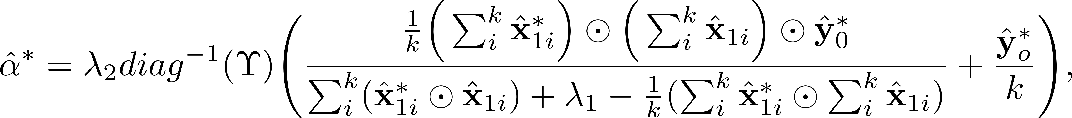
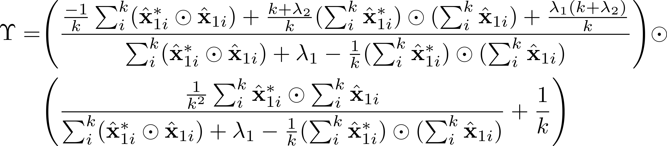
Proposed Method
where
All operations are elementwise!!
Notes:
The solution is given as follows. As you can see not only can now use kernels since we have the solution as byproduct of the templates, but also we can use mutiple template as the final filter update is simply a sum of all templates. This was not possible before as we had to choose between the two.
(22 seconds)

Slide 9
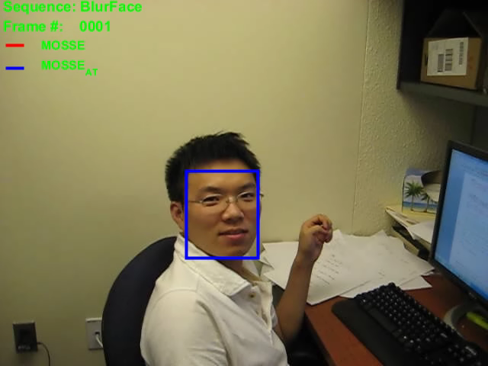
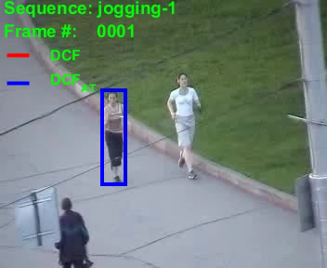
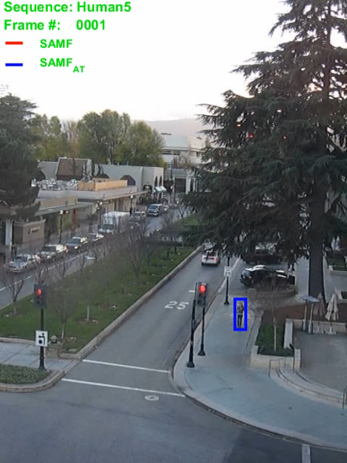
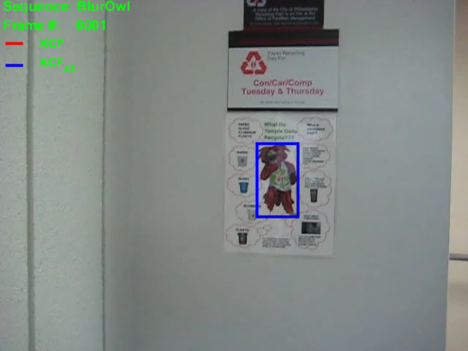
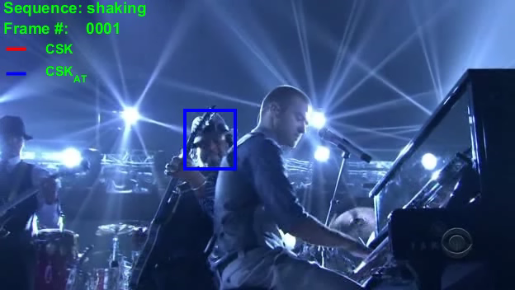
Qualitative Results
“Object Tracking Benchmark”, TPAMI2015
Notes:
We have tested our framework on 5 baseline correlation based trackers only to improve all of them.
Here are some qualitative results where the blue bounding box is the tracking result for the baseline tracker (SAMF,DCF,KCF,MOSSE,CSK), while the red is our framework adapted to it.
As we can see our proposed framework can improve the baseline trackers in the fast motion, motion blur, and occlusion categories significantly.
(28 seconds)

Slide 10
Quantitative Results
Trackers | Precision | Accuracy (IOU)
SAMF_AT | 0.790 | 0.680
SRDCF | 0.788 | 0.728
MEEM | 0.787 | 0.632
MUSTER | 0.773 | 0.681
DCF_AT | 0.728 | 0.590
KCF_AT | 0.723 | 0.582
DSST | 0.693 | 0.534
CSK_AT | 0.586 | 0.501
MOSSE_AT | 0.546 | 0.463
Trackers | MOSSE | MOSSE_AT | CSK | CSK_AT | DCF | DCF_AT | SAMF | SAMF_AT
Precision | 0.414 | 0.546 | 0.543 | 0.586 | 0.690 | 0.728 | 0.752 | 0.790
Accuracy (IOU) | 0.334 | 0.463 | 0.450 | 0.501 | 0.548 | 0.590 | 0.646 | 0.680
“Learning Spatially Regularized Correlation Filters for Visual Tracking”, ICCV2015
Notes:
Lastly we show some quantitive results on OTB100 dataset where we show that all baseline trackers improve in performance overall by factors ranging from (4% – 15%). Some of which also achieve the state of the art performance at the time of submission. The improvement is also shown for the corresponding attributes per sa (motion blur, fast motion, and occlusion).
(20 seconds)
Notes:
+ highlight the baselines in one color boxes and AT versions in another so ppl can see the difference. I think maybe a table of results is better than plots here. The plots don’t hold much information actually.

Slide 11
Target Response Adaptation for Correlation Filter Tracking
[Poster:S-4A-05]
Notes:
Thank you all for coming! We will be very pleased to answer your questions at poster 5.
(6 seconds)
Notes:
+ Add time slot for the posters? Or is that redundant because it will be in the direct next session? (It is right the next session)

